Slide 1


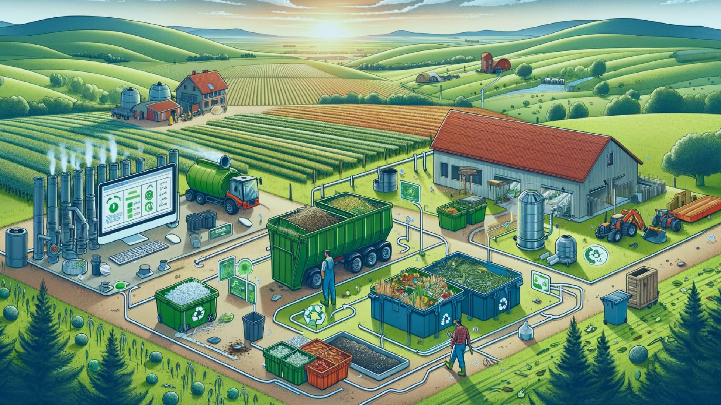




The Quest: Impact Innovators Challenge 2024
Transforming Agricultural Waste: Connecting Farmers with Alcohol Industry for Sustainable Solutions
Team The Philosopher’s Stone
Team Members
Achal Mittal
Divyansh Jindal
Mayank Sharma
Pari Goyal

Slide 2


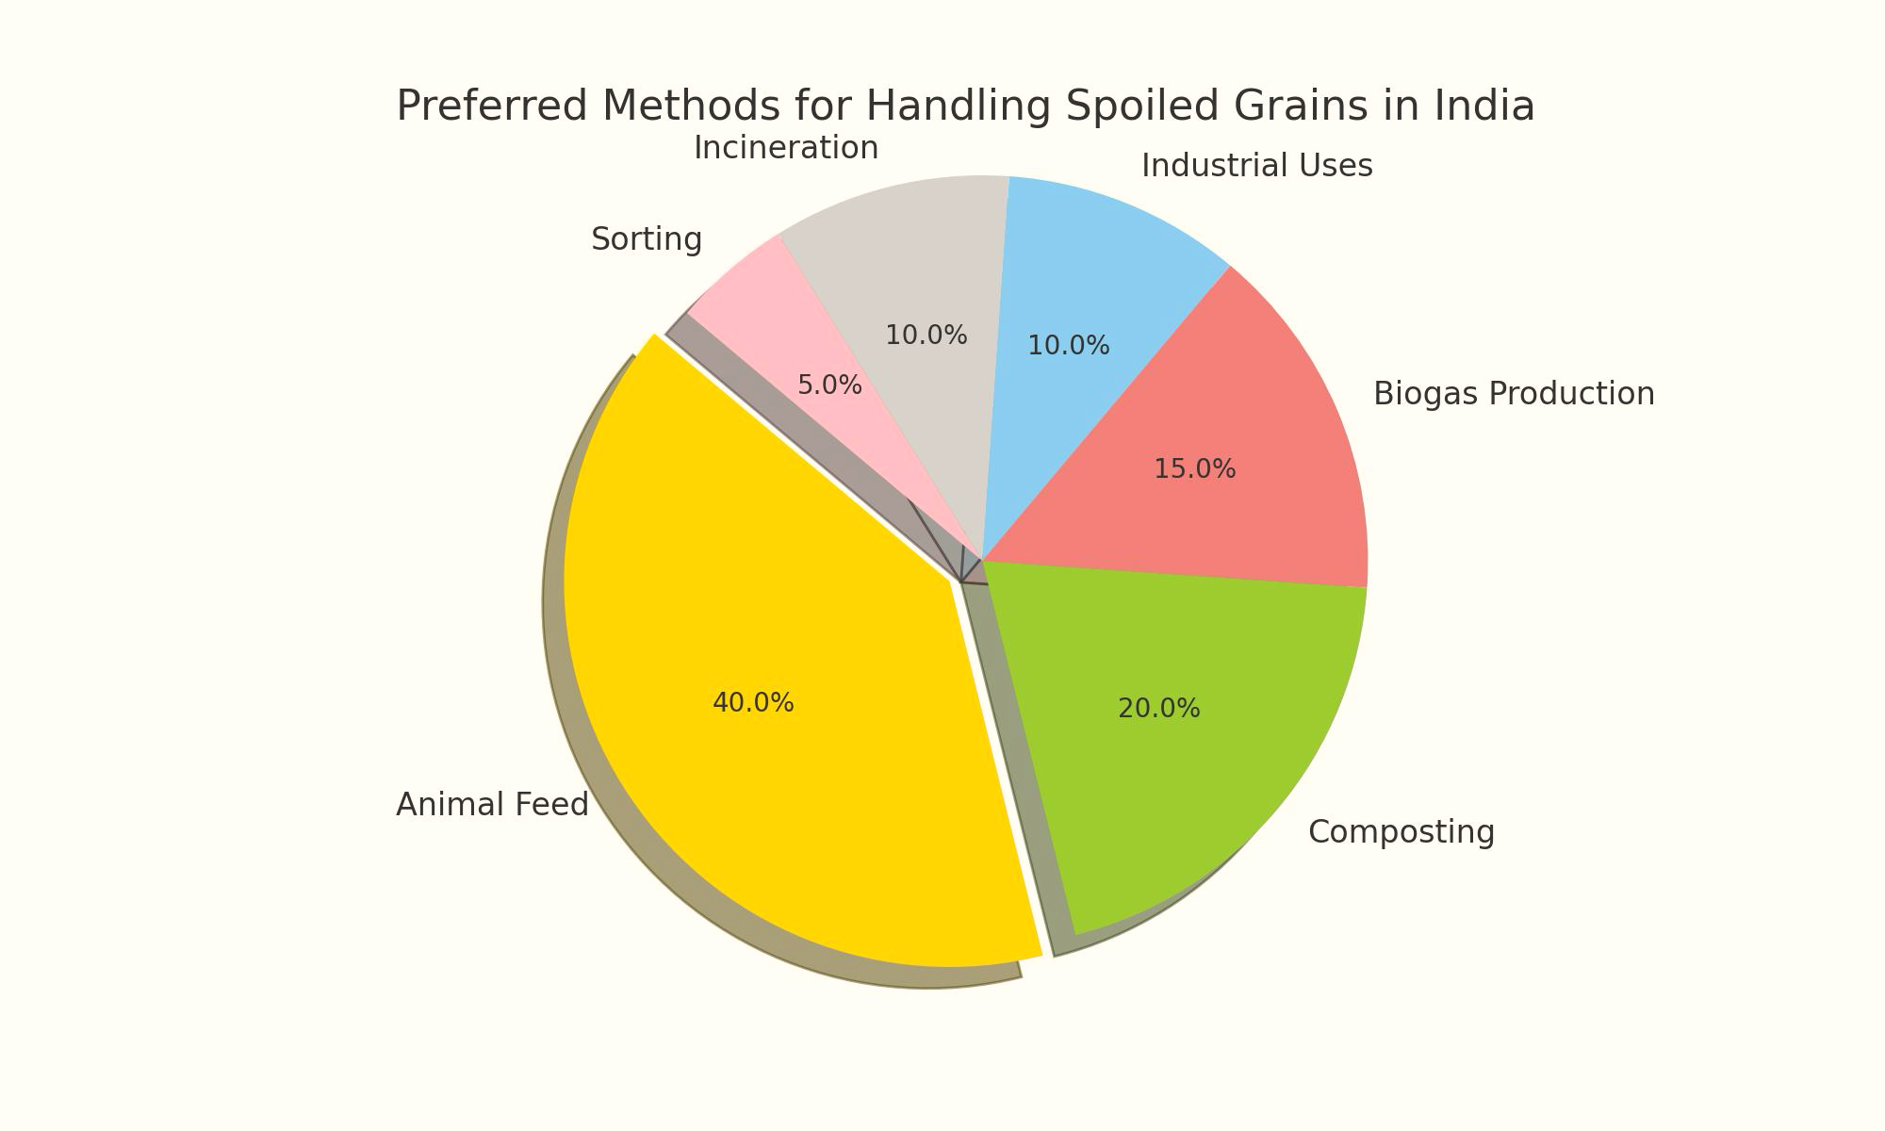







Market Overview
Problem Statement
Indian farmers struggle to sell spoiled grains, worsened by climate change, while distilleries and biofuel businesses face raw material shortages. An online platform connecting farmers with these industries can provide a new sales channel and streamline raw material sourcing.
BUSINESS STRATEGY
RISKS & MITIGATION
Key Facts Pertaining to the
Crop Failure Market
197.81 lakh Tons
Grains wasted in the FY 2022-23
6%
Total crop yield that goes to waste (in FY 2021-22)
300 Lakh Tons
Annual Demand for distilleries & breweries(all beverages are food crop based)
505 Crore Liters Annual Biofuel Production Capacity (Utilizing food grains )
Sources: PIB, ICAR , UNEP, Statista
1
3
Spoiled Grain Utilization Ways
4
Food Grains can be used in ethanol production
Farmers Pain Points
4
Reduced Income due to unsold grains
Unsold surplus triggers borrowing, creating debt trap
Lack of a suitable platform for selling spoiled grains
Stress and anxiety from inability to repay debt
Target Segment
Strategy
Paddy
Millets
Sorghum
Wheat
Millets
Corn
2
Insights from Secondary Research
5
Obstacles in the biofuel, distillery, and brewery industries
Government schemes exist to mitigate crop failures, including subsidies and insurance
Struggles to secure competitive grain prices Lack of efficient marketplaces for grain procurement
Spoiled grain supply is erratic
Challenges in aligning farmer production with industry demand
Monetary loss of Rs 20,698 Cr due to spoiled grain in FY 2021
Climate events like droughts and floods are increasing, leading to higher crop failures
Spoiled grains are often used as low-value animal feed, generating minimal income
Rs 2/kg animal feed grain price impacts
Farmer’s
income
Risks food security
Distorts the
market
Significant annual financial losses

Slide 3




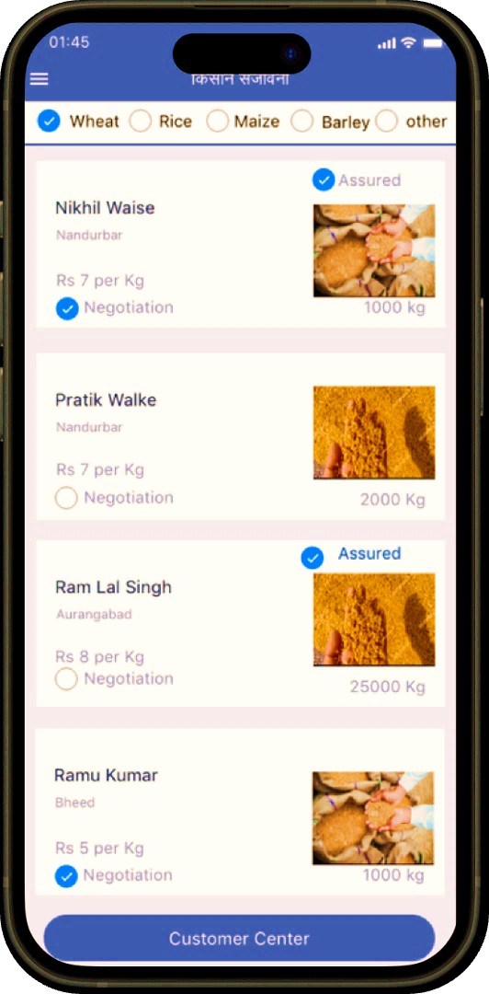


Business Model- किसान संजीवनी
Establish Kisan Sanjeevani as a major market player in minimizing crop waste
Phase 1
Phase 2
Phase 3
BUSINESS STRATEGY
RISKS & MITIGATION
Q1
Q2 Q3 Q4
Q1
Q2
Q3
Q4
Launch and Pilot Project
Expansion and Revenue Generation
Growth
Launching and Expanding Revenue generation post-expansion phase (launch The Nimbus Land event)
Installation of Kiosks at multiple locations
Scaling the Model to different states
Backend and UI development enhancements
Platform Fee for Transporters
Subscription Fee for Distilleries
Marketing campaigns to improve brand visibility & awareness among customers
Raising Awareness on Social Media
Collaborating with Govt and NGOs
1
Customer Segments
Marketing campaigns to improve brand visibility & awareness among customers
Collaborating with NGOs
3
Mobile Application Layout Kisan Sanjeevani
4
Financial Analysis and Roadmap
Primary Segments
Farmers and mandi middlemen with spoiled grains
Distilleries, breweries, and biofuel producers requiring raw materials
Secondary Segments
Agricultural cooperatives
Government bodies and NGOs focused on sustainability and agriculture
Revenue Streams
Marketplace for Sourcing Grains for Ethanol Production
Quality Assurance for Grain Procurement
Consistent Sourcing for Industrial Needs
Network of Transport Service Provider
Comprehensive Marketplace for Spoiled Grains sale
Unwavering Payment Assurance for Farmers
Multilingual Capabilities for Effortless Navigation
Voice and Text-Based Communication Options
Transaction fees
⁠Ad Revenue
Platform Fee
⁠Subscription fees
Charged from both buyer and seller
Income from website and app ads
for the Breweries and Distilleries
for Transportation service providers
Cost Streams
2
Customer Relationships
App Development
Cost of app development and maintenance
Marketing & Promotion
Cost of running marketing campaigns
Human Resource
Salaries and employee benefits
Miscellaneous
Market research and other expenses
24/7 customer support via chat, email, and phone
Regular webinars, workshops, and tutorials for education and training
Online forums and community groups for experience sharing and tips
Regular surveys and feedback forms to enhance platform functionality

Slide 4














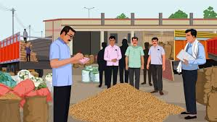








Marketing & Networking Plan
Marketing Slogan in Regional Languages आपकी फसल अधिकतम, आपका कचरा न्यूनतम (Hindi) | तुमचे पीक जास्तीत जास्त, तुमचा कचरा कमीात कमी (Marathi)
BUSINESS STRATEGY
RISKS & MITIGATION
Digital & Mobile Marketing
1
2
Public Relations
3
Direct Marketing
Marketing through Mobile Messages
Press Releases
E-mail Marketing
Create compelling SMS content that emphasizes the key benefits of the platform
SMS in regional languages to expand the reach and enhance connectivity with local farmers
Issue press releases to spotlight the platform's launch, impact
Send targeted emails to breweries and distilleries about the platform’s promotions and relevant news.
Kiosks in APMCs or Mandis
Increasing Social Media Reach
Creating a physical presence in Agricultural Produce Market Committees (APMCs) or Mandis
Local and National Media Outlets
Prioritize locations were target industries
User-friendly kiosks equipped with computers
Collect feedback from users to improve the platform and address
Share compelling stories with local and national media highlighting the platform’s transformative impact on farming and environmental sustainability
Rationale - Helping us in increasing the reach, relevance, resonance
Instagram influencers
Santosh Jadhav – MH |Pramod Prajapati - MP | Robin Tyagi - UP
Micro influencers - From Tier 1,2 & 3 cities having a follower base between 30k - 80k users on respective social media accounts
Local Mandis or APMCs
Collaboration with Associations
Collaboration with NGO and Govt.
Networking and Collaborations
State | Number of APMCs
Maharashtra | 900
Uttar Pradesh | 630
Partner with local mandis and APMCs to identify farmers with spoiled crops
Use mandi networks to promote platform adoption among farmers
Coordinate with mandi officials to streamline the process of collecting and selling spoiled grains.
Collaborate with agricultural and industrial associations to expand platform outreach
Leverage relationships with chambers of commerce to enhance credibility and visibility
Partner with agricultural and environmental NGOs to promote sustainability
Pursue government grants and funding for platform development and expansion

Slide 5

REFERENCES
Key Articles and research underpinning our strategy to address crop waste
https://nsi.gov.in/study-materials/Overview_of_Alcohol_Production_07042020.pdf
Personalization
45% Users
https://www.thehindu.com/news/cities/Kochi/12-lakh-kg-of-damaged-foodgrains-sold-off-for-making-cattle-feed/article66463487.ece
https://desagri.gov.in/wp-content/uploads/2023/05/Agricultural-Statistics-at-a-Glance-2022.pdf
1
POTENTIAL
https://www.indiatoday.in/india/story/india-grows-more-food-wastes-more-while-more-go-hungry-1752107-2020-12-22
Reaching certain level of threshold, Nimbus land can be expanded geographically to involve more and more audiences over time
https://nsi.gov.in/study-materials/Overview_of_Alcohol_Production_07042020.pdf
https://pib.gov.in/Pressreleaseshare.aspx?PRID=1562702
https://www.mydrinkbeverages.com/alcoholic-beverage-development-based-on-starchy-materials
Partners will be given opportunity to come up with new food inventions
THANK YOU

